Slide 1
Lead Scoring Case Study Presentation
By:
Sharath Chandra VC
Md Ibrahim Shariff

Slide 2
Problem Statement
X Education sells online courses to industry professionals.
X Education gets a lot of leads, its lead conversion rate is very poor. For example, if, say, they acquire 100 leads in a day, only about 30 of them are converted.
To make this process more efficient, the company wishes to identify the most potential leads, also known as ‘Hot Leads’.
If they successfully identify this set of leads, the lead conversion rate should go up as the sales team will now be focusing more on communicating with the potential leads rather than making calls to everyone.
Business Objective:
X education wants to know most promising leads.
For that they want to build a Model which identifies the hot leads.
Deployment of the model for the future use.

Slide 3
Solution Methodology
Data Cleaning and Data Manipulation.
Check and handle duplicate data.
Check and handle NA values and missing values.
Drop columns, if it contains large amount of missing values and not useful for the analysis.
Imputation of the values, if necessary.
Check and handle outliers in data.
EDA:
Univariate data analysis: value count, distribution of variable etc.
Bivariate data analysis: correlation coefficients and pattern between the variables etc.
Feature Scaling & Dummy Variables and encoding of the data.
Classification technique: logistic regression used for the model making and prediction.
Validation of the model.
Model presentation.
Conclusions and recommendations.

Slide 4
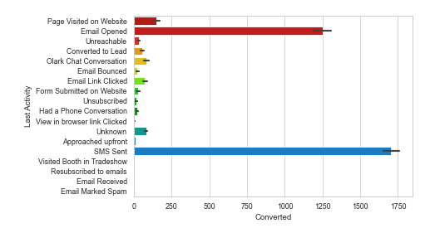
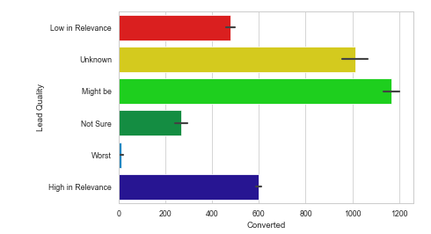
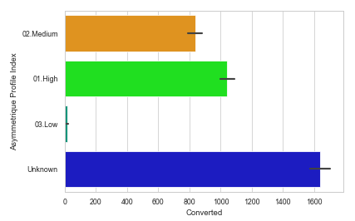
EDA

Slide 5
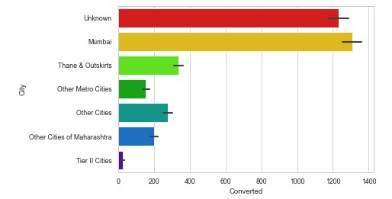
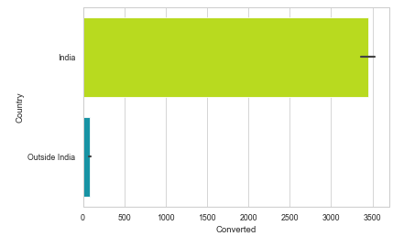
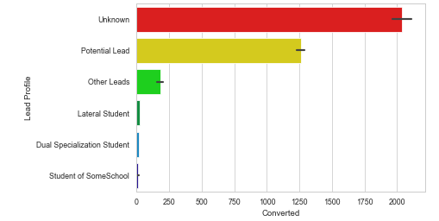

Slide 6
Data Conversion
Numerical Variables are Normalized
Dummy Variables are created for object type variables
Total Rows for Analysis: 8792
Total Columns for Analysis: 43

Slide 7
Model Building
Splitting the Data into Training and Testing Sets
The first basic step for regression is performing a train-test split, we have chosen 70:30 ratio.
Use RFE for Feature Selection
Running RFE with 15 variables as output
Building Model by removing the variable whose p-value is greater than 0.05 and vifvalue is greater than 5
Predictions on test data set.
Overall accuracy 81%.

Slide 8
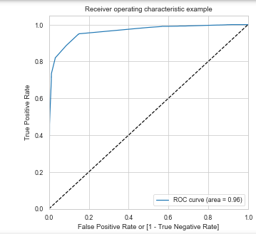
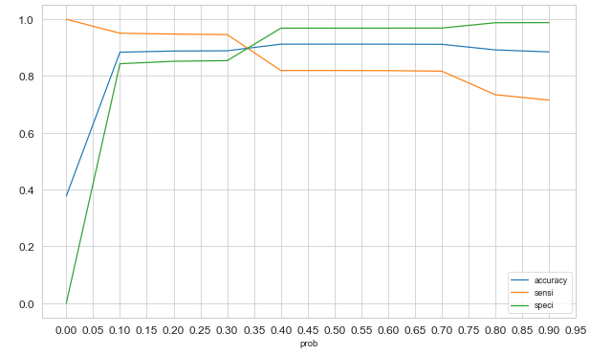
ROC Curve
Finding Optimal Cut off Point
Optimal cut off probability.
Probability where we get balanced sensitivity and specificity.
From the second graph it is visible that the optimal cut off is at 0.35.

Slide 9
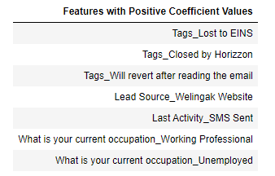
Conclusion
The conversion probability of a lead increases with increase in values of the following features in descending order:

Slide 10
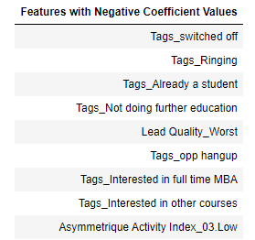
The conversion probability of a lead increases with decrease in values of the following features in descending order:
Another point to note here is that, depending on the business requirement, we can increase or decrease the probability threshold value with in turn will decrease or increase the Sensitivity and increase or decrease the Specificity of the model.
High Sensitivity will ensure that almost all leads who are likely to Convert are correctly predicted where as high Specificity will ensure that leads that are on the brink of the probability of getting Converted or not are not selected.

Slide 11
Thank you ☺

